Slide 1
admiral Workshop
Can we collaborate to lessen the burden of ADaM?
PHUSE EU Connect 2021
Notes:
Optional pre-read: Introduction to R for the Statistical Programmer: https://atorus-research.github.io/phuse_intro_to_r_2021_website/ (see Content & Resources sections)

Slide 2




Notes:
Firstly, in these virtual working times of back to back video-calls, let’s all take some time to be present. We believe this workshop could be an industry game-changer, but we only have a chance of achieving that with your attention. So please close your email inbox, mute notifications on your chat tool, and join us back here for what we promise will be a fun and thought-provoking use of your time. Now if you’re all back with us, next take a second to clear your mind from the last meeting you came from or whatever’s going on in the other rooms around you… if it helps imagine yourself on the beach shown now, or consider your place in our endless universe, or even just imagine what beer you might be choosing later if this wasn’t a virtual conference! Now we’ve hopefully got your attention, let’s continue.

Slide 3
How we’ll spend the next 2.5 hrs of your valuable time…
Audience Participation Menti - framing the industry ADaM challenge
Presentation - admiral intro
Hands-on trial – try before you buy “use for free via open source!”
Demo – additional features
Panel – open Q&A with team members
Closing – next steps & wider vision
Notes:
2.5 hrs sounds a lot, but in this time programming you might manage to program a few ADaM variables (or maybe 1 if your programming is as rusty as mine!) – so hopefully spending this time instead with us today you’ll learn more about admiral where a whole bundle of ADaM derivations will be made available for you to re-use for free. Thus we hope to give you back the gift of time!
Also as we appreciate the length of the session we’ll plan for a couple of comfort breaks along the way.
Intro presenters & the agenda.

Slide 4
Framing the Challenge
Notes:
Optional pre-read: Introduction to R for the Statistical Programmer: https://atorus-research.github.io/phuse_intro_to_r_2021_website/ (see Content & Resources sections)

Slide 5

Framing the Challenge – WE NEED YOU!
We’d like to start by asking you all some questions about your current state ADaM solutions and your perspectives around this
To do this you’ll need to connect to Menti.com from your computer or smart device and enter the code we show next
Please answer honestly, as there are no right or wrong answers and everything is anonymous
Notes:
Menti: https://www.mentimeter.com/s/9063a5b0c5b5e315037a263c02e74e84/8c10652d369e/edit
Link findings back to our purpose:
Across the pharmaceutical industry we all face a similar challenge when it comes to analysis and creating ADaM datasets:
We all face the challenge of a changing and novel data landscape with new therapeutic areas and analysis concepts – ADaM is endless!
Yet we all work on our own “standard black-box solutions” for ADaMs tending to see siloed and hierarchical approaches as more efficient than a collaborative approach

Slide 6


Our Story
Both Roche & GSK had been exploring use of open source languages (primarily R) in areas of clinical reporting such as TLGs, interactive displays and QC
For ADaM, we each had heavily invested in SAS® macro based tools to achieve our company-specific implementations
Realisation came from both sides that given the endless nature of ADaM there had to be potential to collaborate on a modular framework, to give the platform for this challenge to enable across-industry crowd-sourcing
LinkedIn post -> Video call -> Programming heads talk
Notes:
Link our story back to challenges from the audience Menti findings to show where our experiences align.
Explain the issues we had with our current tools: tended to be big all encompassing tools that created 100’s of derivations and became somewhat of a black box to debug and a new language for users to learn, often led to lots of pre and post processing needed and this work was being buried at study level so not easily re-usable.
Share how during the early calls in Jan we found very similar past experiences and challenges, shared ideas of how to move forwards, and in the most part we had fairly well-aligned standards implementations – and most importantly we were willing to compromise (as endeavours like this make you question do we really need so many company-specific approaches!). Then In Apr we took the idea to a group of big pharma programming heads and were amazed that another 11 companies (which grew to 15) wanted to join us on the journey and commit to trialling our co-developed solution.

Slide 7
Introducing admiral
Notes:
Optional pre-read: Introduction to R for the Statistical Programmer: https://atorus-research.github.io/phuse_intro_to_r_2021_website/ (see Content & Resources sections)

Slide 8


Introducing admiral (ADaM In R Asset Library)
admiral is an open source modularized toolbox that enables companies and communities to develop ADaM datasets in R.
Think of admiral as a toolbox of modular blocks (R functions) →
each block has a stand alone purpose (each function provides a specific functionality)
Data Scientists can create their own blocks (create own R functions)
Constructing an ADaM dataset should become like building out of blocks that are based on admiral modular functions and user-created modular functions.
AGILE/SCRUM Team

Slide 9



Way to go!
Enable
Collaborate and contribute
Co-create and re-use

Slide 10
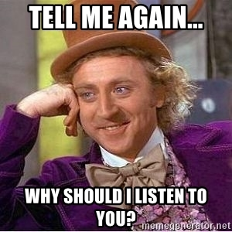
What’s in it for you?
As a company: harmonization & robustness
A robust framework for R-based ADaM shared ready-to-use modules
Imagine ADaM code becomes more transparent across the industry (QC, readable code, talent flow ..)
As a Data Scientist: contribute to something bigger
An option to make a name for yourself in the Pharma open-source community (i.e. an extension of just sharing a paper), and an avenue to collaborate with other like-minded people across the world
Share, re-use and inheritance as a community instead of re-inventing the analysis for each study
Patients & Society: concentrate on the right work
If we can collectively reduce the burden of ADaM across-industry, imagine the data scientist skills and resources this unleashes towards making more with the insights of our data, and the speed at which we’re able to bring treatments to patients

Slide 11

How we see industry collaboration working?
admiral
company
(open-source)
company
(internal)
core
admiral.roche
internal
Does admiral extend?
core
admiral.gsk
internal
Can we move the wall?
core
admiral.you
internal
Your Org
common
ADaM Dataset Requirements
bespoke
Notes:
Explain may need a company-specific function in some cases (e.g., SMQs)

Slide 12
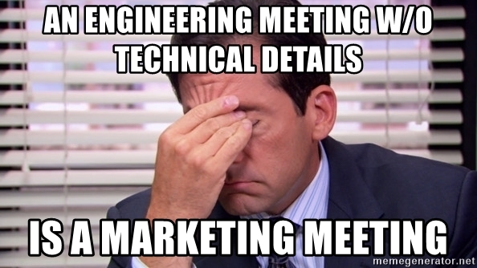
Let’s dive in deeper…
admiral site: https://roche-gsk.github.io/admiral/index.html
R functions include example calls and are unit tested (with >80% coverage level) to create the common standards for the following datasets:
ADSL (~50%)
BDS: ADVS, ADEG, ADEX (70-80%)
OCCDS: ADAE, ADCM (80%)
Vignettes how to create ADSL, BDS and OCCUR datasets, including example scripts, but functions can also be used for other datasets
Tested across various SDTM & ADaM versions
R Platform / Environment: no explicit requirements. Suggest R ≥ v3.5.
Direct Package Dependencies: assertthat, dplyr, lubridate, magrittr, purrr, rlang, stringr and tidyr
Notes:
Roche/GSK development team used SDTM version 1.4 & ADaM 1.1 (Roche) & 1.2 (GSK) – but then we tested with 15 other companies using their own different variations.
On the point of CDISC compliance of ADaMs created via admiral: we have set up all functions to not violate CDISC rules, but compliance is in the user’s hands. This is not a Pinnacle 21 package.
On topic of validation, best development practices have been followed to ensure reliability of functions and then as part of our open source release we’ll also include a generic package validation report, but this of course would be an internal discussion for each company.

Slide 13
External Testing Read-out
During Sept/Oct we held a testing phase where 15 other companies and >50 programmers were kind enough to commit time to try out admiral
Here’s a summary of the findings:
Notes:
< ADD AFTER SURVEY FINDINGS >

Slide 14
Hands-on Trial
Notes:
Optional pre-read: Introduction to R for the Statistical Programmer: https://atorus-research.github.io/phuse_intro_to_r_2021_website/ (see Content & Resources sections)

Slide 15

Hands-on Trial
To demonstrate how (hopefully) simple the admiral package is to pick up and use we will run a 45 min hands-on session where you can all try it out
Many of our testers gave the feedback “No training needed” – so let’s see!
We have 3 exercises for you to choose from:
Beginner: for those with limited or no prior R or ADaM experience
Intermediate: for those with 1-2 years of R and ADaM experience
Advanced: for those with 3+ years of R and ADaM experience
If you find any issues consult the documentation via link provided, and if still stuck then scroll down and you’ll find all solutions at the bottom of each exercise
Notes:
<ADD EXERCISES (see https://exbpbox.ent.box.com/file/863584506616) – PLAN AS BREAKOUT ROOMS IN ZOOM (SPLIT BY BEGINNER/INTERMEDIATE/ADVANCED)? IF SO, GET SUPPORT FROM OUR TEAM BEYOND THOMAS TO BE ON HAND – SAMIA/GORDON >
5 mins BREAK before and after so give 55 mins total.
Exercises depend on your R and ADaM experience levels – if unsure we recommend start with one of the harder levels and then work your way up to the easier as needed, as they’re all similar underlying exercises.

Slide 16

Hands-on Trial - Setup
We will be using RStudio Cloud
Benefit being we can all use R with the same config, rather than setting up R on each OS
We recommend the Firefox or Chrome browsers
You can find the project associated with the workshop here: https://rstudio.cloud/project/ADD. Once logged in, you should see the Phuse_EU_admiral_workshop_2021 project
Clicking on the project will open an RStudio Session with dummy data available and all required packages pre-installed - you can use this to try out the hands-on exercise of your choosing
Thanks to R/Pharma for allowing us to make
use of this workspace for our workshop!
Notes:
< UPDATE RSTUDIO CLOUD LINK AND SETUP PROJECT READY WITH ALL REQUIRED PACKAGES PRE-INSTALLED AND INPUT DATA READY – WORK WITH MIKE S >
RStudio Cloud link would also have been provided by email prior to the workshop

Slide 17
Demo
Notes:
Optional pre-read: Introduction to R for the Statistical Programmer: https://atorus-research.github.io/phuse_intro_to_r_2021_website/ (see Content & Resources sections)

Slide 18
Demo
A short hands-on trial can only go so far to help you appreciate the toolkit, so here’s an additional live demo to help explore the package a little deeper – including how anyone in the industry could go about contributing their own functions (after we open source release)
Notes:
< THOMAS TO PREPARE – Show how to use the ADaM templates (as the hands-on exercise will only show how to create certain variables, not a whole ADaM) & go over the Developer Guidelines for contributors >

Slide 19
Panel Session
Notes:
Optional pre-read: Introduction to R for the Statistical Programmer: https://atorus-research.github.io/phuse_intro_to_r_2021_website/ (see Content & Resources sections)

Slide 20
Panel Session
We now have the following people available to take your Q&A (20 mins):
Thomas Neitmann - co-technical lead
Suhas Kirani Ravindra – former co-business lead
Michael Stackhouse - external tester
Michael Rimler - co-sponsor
Ross Farrugia - co-sponsor
Notes:
Note for presenters/panelists: PHUSE is programming language neutral, but we should be mindful of SAS connections and the wide array of attendees we’ll likely get. So let’s try to not get drawn into a purely “R vs SAS” debate and focus instead more around the positives that R and the open source movement is enabling us to do, rather than making a critic of SAS.
Some likely questions:
Why choose R instead of SAS? Doesn’t have to be a question of one or the other, but some considerations of why companies might explore R are… Open source with ever expanding packages to benefit from without license costs; Statistical talent pipeline currently more likely to come through with R skills; FDA open to accepting R submissions and are heavy users themselves; Top of the line visualization/graphics; R-Shiny for interactive data displays and also R Markdown offers great report writing functionality; R is very popular among statisticians so new statistical methods are likely implemented in R before any other language
Why choose R instead of Python? Has benefits across data engineering, statistical insights generation and advanced analytics - so offers the potential to train a large pool of data scientists in one main language to cover majority of primary tasks needed; Talent pipeline with statistical background generally have more R experience; There is the possibility to route Python code through R packages so doesn’t always need to be one or the other; GCP/validation considerations for submission further along with R
Would it work on any SCE? All package dependencies and R version tested on has been provided. The testing by the 15 further companies outside of Roche & GSK helped us test portability before we go open source
Could it be linked with company-specific standards repositories? Yes, the package is stand-alone, but companies could add a connection to any metadata repository as required

Slide 21
Closing
Notes:
Optional pre-read: Introduction to R for the Statistical Programmer: https://atorus-research.github.io/phuse_intro_to_r_2021_website/ (see Content & Resources sections)

Slide 22
Next Steps
Our development team are currently focused on enhancing the package for the feedback we received during the recent external testing phase
We target our MIT licensed open source release at the end of this year, but our site and code repo are already open to explore
If you (either as a company or as an individual) are interested to use and contribute to admiral, then please do reach out to ross.farrugia@roche.com & michael.s.rimler@gsk.com
We envisage forming a community to help us maintain and grow this resource for the benefit of all our industry, whilst supporting one another as users

Slide 23










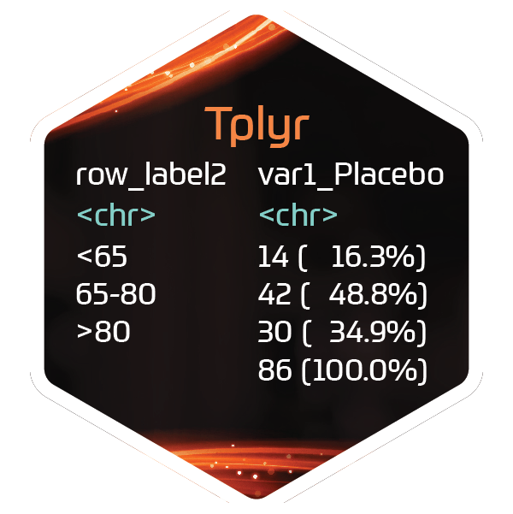


Vision for the Future – “pharmaverse”
?
diffdf
?
?
r2rtf
?
?
?
?
rtables
Notes:
< CREATE AS A SHORT VIDEO – LIKE MARVEL END CREDITS TEEING UP FOR PHUSE US CONNECT WORKSHOP – flash up website? >

